Slide 1
Graphs and Digraphs
Tree

Slide 2
Tree
A tree is a graph in which any two vertices are connected by exactly one path.
Alternatively, any connected graph with no cycles (circuit) is a tree.
Trees are widely used in computer science data structures such as
  binary search trees,
  heaps,
  Tries (prefix trees),
  Huffman trees for data compression etc.

Slide 3
Tree
A tree with n nodes has n-1 graph edges.
Conversely, a cycle-free and connected graph with n nodes and n-1 edges is a tree
All trees are bipartite graphs

Slide 4
Tree
Theorem
  G is connected and acyclic (i.e. G is a Tree)
  G is acyclic and has n-1 edges
  G is connected and has n-1 edges
  G is edge maximal with respect to being acyclic
  G is edge minimal with respect to being connected
  Every pair of vertices in G is joined by exactly one path

Slide 5
Tree
Proof
  To prove the equivalence, a cycle of implication is established.
    (1) => (2) => (3) => (4) => (5) => (6) => (1)

Slide 6
Tree
Proof
  (1) => (2)
    Since p = 1 and ρ(G) = m–n+p = m–n+1=0 because of the assumptions in (1), we have m=n-1
    (1): connected and acyclic
    (2): acyclic and has n-1 edges

Slide 7
Tree
Proof
  (2) => (3)
    Since (2) implies,
    ρ(G) = m-n+p = (n-1)-n+p=0,
    We obtain p = 1
    (2): acyclic and has n-1 edges
    (3): connected and has n-1 edges

Slide 8
Tree
Proof
  (3) => (4)
    p=1 and m = n – 1,
    ρ(G) = m – n + p = (n-1) – n + 1 = 0
    which shows that G is acyclic
    If we were to add an edge then m would be increased by 1 but n and p will remain unchanged
    (3): connected and has n-1 edges
    (4): edge maximal w.r.t being acyclic

Slide 9
Tree
Proof
  (4) => (5)
    If (4) is true then if G was not connected then there would exist an vertices v, w not joined by path. So adjoining a the edge {v,w} would not form a circuit. This would contradict the assumption (4) so we must have p = 1
    (4): edge maximal w.r.t being acyclic
    (5): edge minimal w.r.t being connected

Slide 10
Tree
Proof
  (5) => (6)
    Assuming (5), G is connected, so that every pair of vertices v, w is joined by a path. If there were more than one path from v to w, then deletion of an edge belonging to a second one and not the first would not disconnect G which is contradiction of (5)
    (5): edge minimal w.r.t being connected
    (6): Every pair of vertices in G is joined by exactly one path

Slide 11
Tree
Proof
  (6) => (1)
    (6) implies that G is connected. But if G had circuits then some pair of vertices would be joined by two paths, again a contradiction
    (6): Every pair of vertices in G is joined by exactly one path
    (1): connected and acyclic

Slide 12
Tree
Corollary
  Every connected graph has a spanning tree
Proof
  When G is connected, choose an edge which may be deleted without disconnecting G. Continue this process until it is not longer possible to delete an edge without disconnecting G. Since according to theorem 2.3, (5) is equivalent to (1), we have a (spanning) tree.
    G is edge minimal with respect to being connected
    G is connected and acyclic

Slide 13
Tree
A forest is a disjoint union of trees.

Slide 14
Tree
An alternative procedure for finding circuit rank in any graph.
  Obtain a spanning forest, a spanning tree in each of the p connectivity components and let the edges of G that are not in T be called chords. The latter will be ρ(G) in number.
  The graphical union of T with each individual chord gives rise to a unique circuit in G. The total collection of circuits will be independent and ρ(G) in number

Slide 15
Circuit Rank
The maximum number of independent circuits is called the circuit rank
Or
The circuit rank of a graph G is the minimum number m of edges to remove from the graph to make it cycle-free (circuit free).
  ρ(G) = m - n + p

Slide 16
Circuit Rank
In first method, we were calculating the circuit rank by formula.
In second method, we are first finding the spanning forest and then counting the chords that are removed from the graph to make it spanning forest. The total count of chords is the circuit rank.

Slide 17
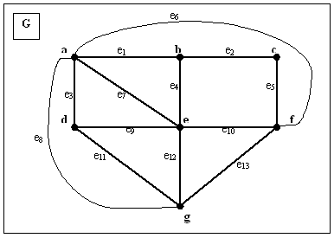
Tree

Slide 18
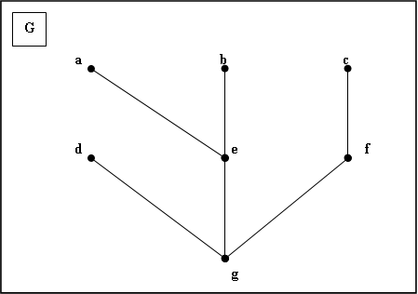
Tree
af:aegfa
ag:agea
ef:egfe
bc:begfcb
de:dged
ad:aegda
ab:aeba

Slide 19
Tree
af: aegfa
ag:agea
ef:egfe
bc:begfcb
de:dged
ad:aegda
ab:aeba

Slide 20
Tree
Application of Spanning Tree
  Pipelines
  Cables
  Railways
  Any other communication or conveyance

Slide 21
Tree
Minimal connector problem
  To find the most economical network linking all nodes
  To achieve the minimal connector problem, we have to make a slight change in the procedure (circuit rank). We choose e₁ to be a cheapest edge, and having already determined the subgraph G_{i-1}, we choose e_{i} to be the most economical link such that G_{i} = G_{i-1} ∪ {e_{i}} is without circuits. The resulting spanning tree G_{n-1} is called an economy tree

Slide 22
Tree
Theorem
  Every economy tree is a minimal spanning tree.

